Slide 1

Process Address Space Verifier: A Novel Defense Against Control Flow Violations
Concept and Proposal
Adam Duby
aduby@uccs.edu
Process Address Space Verifier
Adam Duby

Slide 2
Overview
Problem
Control flow attacks via out of context library calls
Attack Model
Attack Vector: Memory corruption vulnerability in victim process
Attack Actions: Modify control flow to achieve arbitrary code execution
Existing Defenses
Control Flow Guard (CFG)
Code randomization and diversification
Proposed Defense Design
Instrument the process loader to verify memory mapped libraries are in accordance with the intended semantics of the process
Implementation: Win10 (Native API)
Process Address Space Verifier
Adam Duby

Slide 3
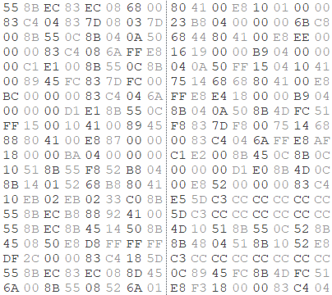
Threat Model
1
2
Software Exploitation
Actions on the Objective
Identify Memory Vulnerability
Stack Overflow
Integer Overflow
Heap
Format String
Code Injection
Shellcode
system(“/bin/sh”)
IP overwrite
Defended with
DEP
Code Reuse
Ret2lib
Return-Oriented Programming (ROP)
Function Reuse
Untrusted Input
Application
Control-Flow Attack / Runtime Exploit
Process Address Space Verifier
Adam Duby

Slide 4
Achieving Arbitrary Code Execution
2
Kernel
Space
ntdll!_PEB
…
+0x00c Ldr : Ptr32 _PEB_LDR_DATA
3
+0x01c InInitializationOrderModuleList : _LIST_ENTRY
User
Space
4
if (FullDllName == “kernel32.dll”)
LoadLibrary(“kernel32.dll”);
GetProcAddress(“DesiredFunctionName”)
PEB
1
Leverage some memory corruption
vulnerability to obtain pointer to PEB:
mov eax, [fs:eax+0x30]
Target Process
Address Space
Process Address Space Verifier
Adam Duby

Slide 5
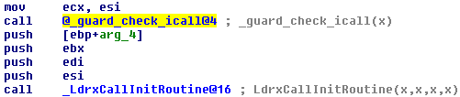
Existing Defenses
Control flow integrity (CFI) & control flow guard (CFG)
Code Pointer Integrity (CPI)
Use bitmap in read-only section of memory to verify indirect call sites
Code randomization & diversification
Not widely implemented
Vulnerable to JIT-ROP attacks (Snow et. al. 2013)
Windows CFG Example
Process Address Space Verifier
Adam Duby

Slide 6
Problem Statement
Problem: Verify integrity of the process address space to detect control flow violations that arise from out of context library calls.
Approach: Utilize the application’s import tables to validate memory mappings and library loading at load time and runtime.
Target Operating System: Windows 10
Implementation: Instrument the Windows loader via NT API Hooking
Advantages of Our Design Proposal
No modifications to compiler toolchain or source code
Support for legacy applications
Runtime verification
Loader instrumentation
Process Address Space Verifier
Adam Duby

Slide 7

Reverse Engineering Methodology
Starting point: kernel32!LoadLibrary(), ntdll!LdrInitializeThunk()
Use gflags to enable the loader snaps flag in the registry
Turning on the global FLG_SHOW_LDR_SNAPS flag enables loader debugging output in kernel debugger
IDA Pro for static code analysis of kernel32.dll, ntdll.dll, and ntoskrnl.exe
WinDbg and Immunity Debugger for runtime analysis
Loader Snaps Output Sample
Process Address Space Verifier
Adam Duby

Slide 8
Process Loading Overview
PE32
program.exe
Parent process calls:
ntdll!LdrInitializeThunk(){
ntdll!LdrpInitializeProcess()
}
Stacks
Heap
PEB
Image
Library 1
Library n
.text
.idata
kernel32.dll
User mode subsystem DLLs
(i.e. user32.dll)
.rdata
.data
kernelbase.dll
.pdata
.reloc
ntdll.dll
user
Kernel Space
Application on Disk
ntoskrnl.exe
hal.dll
kernel
Process Address
Space
Process Address Space Verifier
Adam Duby

Slide 9
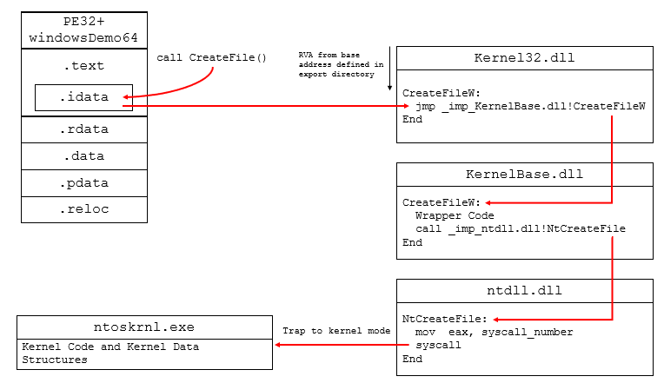
Program Execution
Process Address Space Verifier
Adam Duby

Slide 10
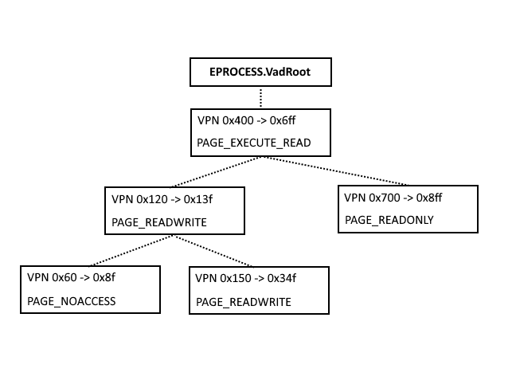
Virtual Address Descriptors (VAD)
_LDR_DATA_TABLE_ENTRY
+0x050 DdagNode : Ptr32 _LDR_DDAG_NODE
0:000> dt ntdll!_LDR_DDAG_NODE
+0x000 Modules : _LIST_ENTRY
+0x008 ServiceTagList : Ptr32 _LDR_SERVICE_TAG_RECORD
+0x00c LoadCount : Uint4B
+0x010 LoadWhileUnloadingCount : Uint4B
+0x014 LowestLink : Uint4B
+0x018 Dependencies : _LDRP_CSLIST
+0x01c IncomingDependencies : _LDRP_CSLIST
+0x020 State : _LDR_DDAG_STATE
+0x024 CondenseLink : _SINGLE_LIST_ENTRY
+0x028 PreorderNumber : Uint4B
VAD Tree
VAD Interface:
ntdll!NtMapViewOfSection() // Insert node or decrement count
ntdll!NtUnMapViewOfSection() // Delete node or decrement count
Process Address Space Verifier
Adam Duby

Slide 11
Defense Concept
PE32
program.exe
Load time:
Instrument the loader via function hooking
Extract dependencies from import section of PE32
Construct binary tree of dependencies with node counts
Run time:
Out of context library calls will increment the VAD node count
Discrepancy in tree reveals out of context library call
.text
.idata
.rdata
.data
.pdata
.reloc
Application on Disk
Process Address Space Verifier
Adam Duby

Slide 12
Defense Concept
// Load Time Node Count
// (Before execution is transferred to application entry point)
_LDR_MODULE peb_ldr_module;
Obtain address of peb_ldr_data.InLoadOrderModuleList.Flink;
while(ReadProcessMemory())
loadCount = peb_ldr_module.LoadCount;
get address of next peb_ldr_module.InLoadOrderModuleList.Flink; }
// Hook NtMapViewOfSection() and NtUnMapViewOfSection()
ZwQueryVirtualMemory() to obtain actual node count
if (section.nodeCount > peb_ldr_module.LoadCount)
throw exception;
Process Address Space Verifier
Adam Duby

Slide 13
Challenge 1 – Delay Loading
Dynamic linking:
#pragma comment(lib, "myDLL.lib")
Delay loading (runtime dynamic linking):
typedef int (*Message)(void);
Message _Message;
HINSTANCE hInstLibrary = LoadLibrary("myDLL.dll");
_Message = (Message)GetProcAddress(hInstLibrary, "Message");
Solution: Augment the import table to include delay loaded libraries
Process Address Space Verifier
Adam Duby

Slide 14
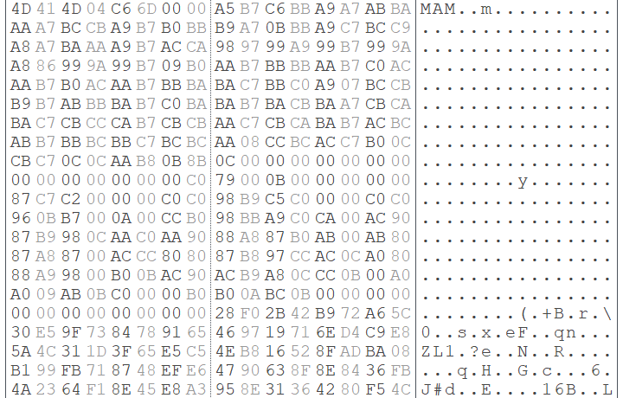
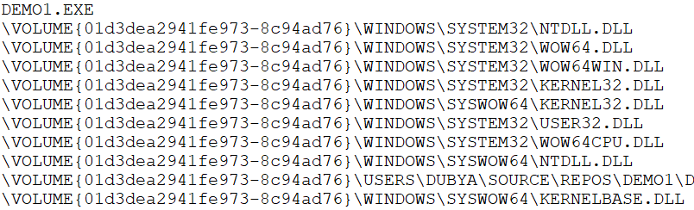
Challenge 2 – Prefetch Buffers
RtlDecompressBuffer(COMPRESSION_FORMAT_XPRESS_HUFF)
Prefetch Buffer
Decompressed Prefetch Buffer
Solution: Build dependency tree from buffer and cross reference .idata section to obtain node count
Process Address Space Verifier
Adam Duby

Slide 15
Evaluation
Performance overhead
Anticipate load time and runtime performance hits
Mutex locks to protect critical regions (loading and unloading)
Considerations:
Prefetch buffers
ASLR
Effectiveness
Simulate attacks with debugger (manual redirection)
Process Address Space Verifier
Adam Duby

Slide 16
Process Address Space Verifier: A Novel Defense Against Control Flow Violations
Concept and Proposal
Adam Duby
aduby@uccs.edu
Process Address Space Verifier
Adam Duby

